Slide 1
Remote Controller
Preliminary Industrial Design

Slide 2
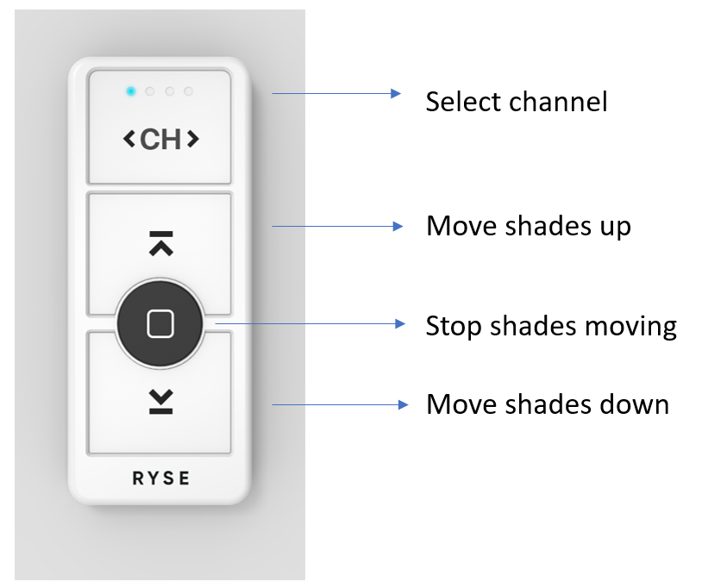
Front

Slide 3
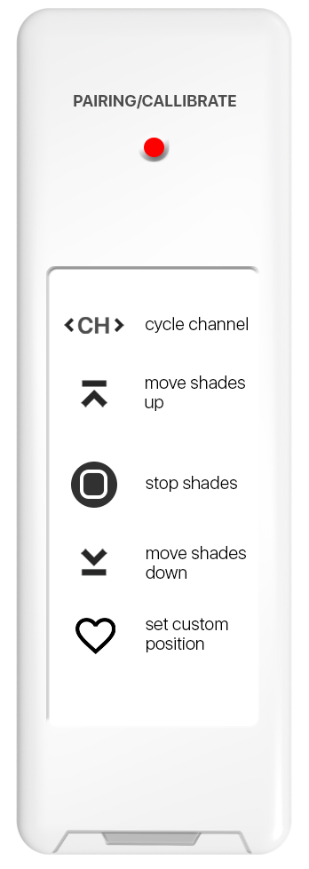
Back
Reset button
Coin cell Battery Slot (Doesn’t have to be here)

